Slide 1







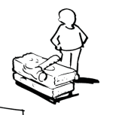
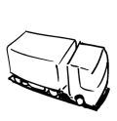


Business Model Canvas
Key Partners | Key Activities | Value Propositions |  | Customer Relationships | Customer Segments
 | Key Resources |  |  | Channels
Cost Structure |  |  | Revenue Streams
http://www.businessmodelgeneration.com
Notes:
(*): COGS: Cost of Good Sold (Includes all manufacturing costs)

Slide 2
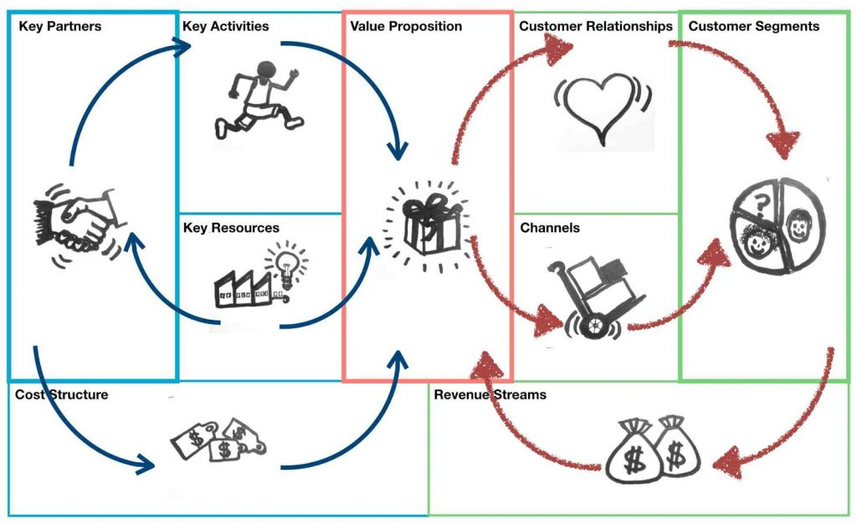
Business Model Canvas
7
2
1
5
4
6
3
9
8

